Slide 1
Summer of Data Science Book Club Ch. 1: Data Visualization with ggplot2
library(dplyr)
rladies_global %>%
filter(city == 'Charlottesville')
Charlottesville
July 2, 2018

Slide 2

Welcome!
Pick up a temporary parking pass
Wifi: VividCortex_Guest (no password)
Follow us on Twitter: @RLadiesCville
Notes:
Ask about experience
Fix hand

Slide 3




Sponsors + Friends (for now)
Look at all of this empty space!

Slide 4
Get involved
Learn
Join our Meetup page and attend events
Follow us on Twitter @RLadiesCville
Contribute
Join our GitHub page
Slack channel?
Ask questions
Organize
Lead a workshop
Give a talk
Ask your company to sponsor us
Be a co-organizer!

Slide 5
Agenda for today:
Introductions
The Layered Grammar of Graphics
Walkthrough: Exercises
Questions?
Planning for next time

Slide 6
1. What is the Summer of Data science?

Slide 7
#SoDS18
Created in 2017 by “Data Science Renee” AKA Renee Teate AKA @BecomingDataSci on Twitter
The main goal of the Summer of Data Science is to learn something new during a fixed period of time, and share your progress and references to help and inspire others (and to get help from and get inspired by others, too!)
For more info: https://www.becomingadatascientist.com/category/sods/
Notes:
She reached out to me personally about being involved, she’s from Harrisonburg and will be coming down to some of our Meetups

Slide 8
2. How is R-Ladies Cville participating?

Slide 9
R4DS Book Club
We’re going to work through R for Data Science together!
The book is available for free online: http://r4ds.had.co.nz/
Hard copies available from Amazon ($20)
The goal is to tackle one chapter every two weeks
Notes:
- Note smaller chapters will be combined

Slide 10
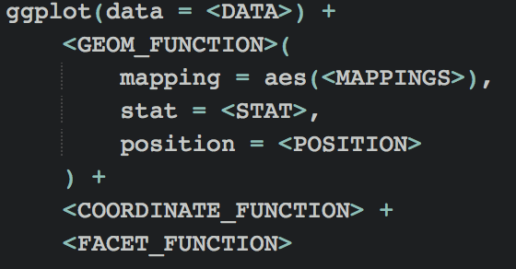
The Layered Grammar of Graphics
You can uniquely describe any plot as a combination of a dataset, a geom, a set of mappings, a stat, a position adjustment, a coordinate system, and a faceting scheme
Notes:
Aesthetics: the x and y locations of a point are themselves aesthetics

Slide 11
ggplot2
Loaded from the tidyverse package: library(tidyverse)
Aesthetic Mappings: visual property of objects in your plot – levels
Facets: subplots that each display one subset of the data
Geoms: geometric object that a plot uses to represent data, i.e. the type of graph (barplot, scatterplot, line graph, etc.)
Stats: summarize the data (with geom)
Coordinate Systems: default is Cartesian (x and y act independently), however can be flipped to create something more interesting
Notes:
We went over a lot of this a couple months ago with Marieke

Slide 12
Aesthetic Mappings
Color, point size, shape, etc.
aes() gathers together each of the aesthetic mappings used by a layer and passes them to the layer’s mapping argument
The x and y locations of points are themselves aesthetics
To set an aesthetic manually, put it outside of aes()
Notes:
We went over a lot of this a couple months ago with Marieke

Slide 13
Facets
Particularly useful for categorical variables
To facet by a single variable, use facet_wrap()
To facet on the combination of two variables, use facet_grid() with ~ to separate your variables

Slide 14
Geometric Objects
You can use different geoms to plot the same data (EX. point vs. smooth)
Every geom takes a mapping argument
If you place mappings in a geom function, ggplot2 will treat them as local mappings for that layer only (so you can show diff aesthetics in diff layers)
Every geom has a default stat and every stat has a default geom

Slide 15
Statistical Transformations
Summarize the data in different ways (EX. counts, loess line, confidence intervals, etc.)
Generally interchangeable with Geoms unless you need to override the default stat or mappings

Slide 16
Coordinate Systems
coord_flip() switches x and y axis – useful for horizontal boxplots
coord_quickmap() sets aspect ratio correctly for maps - spatial data
coord_polar() used polar coordinates – pie chart
Notes:
Required packages

Slide 17
Next Steps
What is the best layout and structure for you?
Do you want to lead a chapter session?
Does this day/time/location work?
Next session: Monday July 16, 5:30pm
Topic: Workflows: Basics, Scripts, and Projects
Notes:
Classroom style, where someone ”teaches” us a chapter
Like today: go through notes and answer questions
Work through it independently or in small groups during this time
Work through it together, question by question?
Alternative location? Coffee shop? Work session?

Slide 18
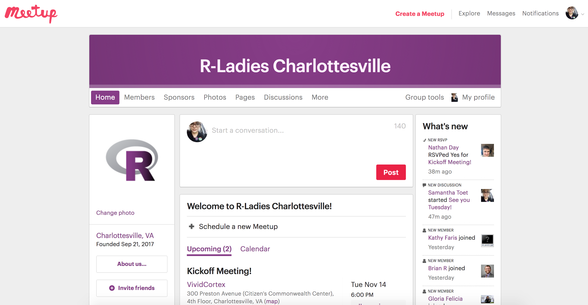
Find us online!
Website: https://rladies.org
Want to help create an R-Ladies Charlottesville site?
Twitter: @RLadiesCville
Meetup: https://www.meetup.com/rladies-charlottesville/
Github: https://github.com/rladies-charlottesville
Slides to be posted here
Check out the R crossword puzzle from RLadiesDC!
Email: charlottesville@rladies.org/ samantha@rladies.org

